Slide 1
Local Adaptive Support Vector Machine for Object Recognition
Nayyar A. Zaidi & David McG. Squire
Group 9: Đỗ Đặng Minh - 1311015
Huỳnh Công Toàn - 1311026
Hồ Văn Tấn - 1311058
Supervisor: Dr. Trần Thái Sơn
Machine Learning – Computer Science – Ho Chi Minh City University of Science
Notes:
Version: 1.1.1
Last update: October 16, 2014

Slide 2
Contents
1
Support Vector Machine
2
Local Support Vector Machine
3
Local Adaptive Support Vector Machine
4
Experimental Results
5
Discussion
Notes:
In this work, we have extended this Local SVM (LSVM) formulation. Our Local Adaptive SVM (LASVM) formulation trains a local SVM in a modified neighborhood space of a query point. The main contributions of the paper are twofold:
First, we present a novel LASVM algorithm to train a local SVM.
Second, we discuss in detail the motivations behind the LSVM and LASVM formulations and its possible impacts on tuning the kernel parameters of an SVM.
We found that training an SVM in a local adaptive neighborhood can result in significant classification performance gain.
Experiments have been conducted on a selection of the UCIML, face, object, and digit databases.

Slide 3
Support Vector Machine
Support Vector Machine
Based on the principle of structured risk minimization
Popular tool for classification
State of the art performance on a wide range of classification data sets
Finds an optimal hyperplane to separate data into two classes

Slide 4
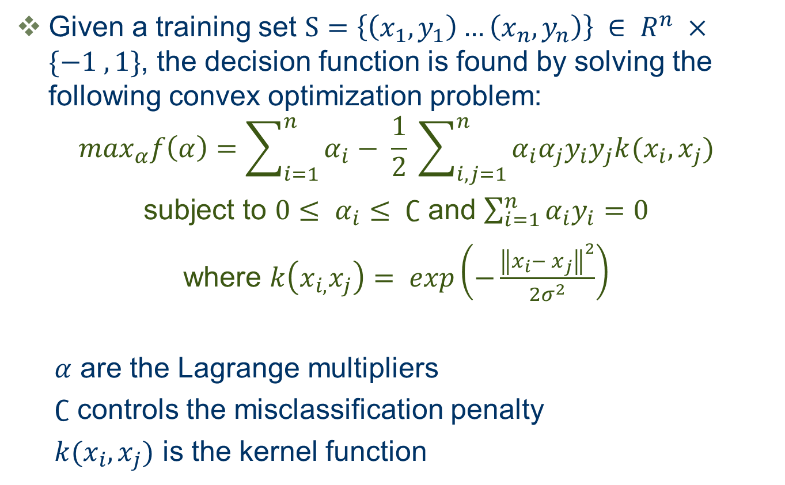
Support Vector Machine
Given a training set $S=\left\{\left(x_{1}, y_{1}\right)…\left(x_{n}, y_{n}\right)\right\} ∈ R^{n} ×\{−1 , 1\}$, the decision function is found by solving the following convex optimization problem:
$$\max_{α}f\left(α\right)=\sum_{i=1}^{n}{α_{i}− \frac{1}{2} \sum_{i,j=1}^{n}{α_{i}α_{j}y_{i}y_{j}k(x_{i},x_{j})}}$$
subject to $0≤ α_{i}≤ ∁$ and $\sum_{i=1}^{n}{α_{i}y_{i}=0}$
where $k\left(x_{i,}x_{j}\right)= exp\left(−\frac{{\left\|x_{i}− x_{j}\right\|}^{2}}{2σ^{2}}\right)$
$α$ are the Lagrange multipliers
$∁$ controls the misclassification penalty
$k(x_{i},x_{j})$ is the kernel function
(1)

Slide 5
Support Vector Machine
Binary classification problems
Multi-class classification
one-versus-all
one-versus-one
Systems become more and more complicated as the number of classes increases
Any time a class is added, all classifiers have to be retrained

Slide 6
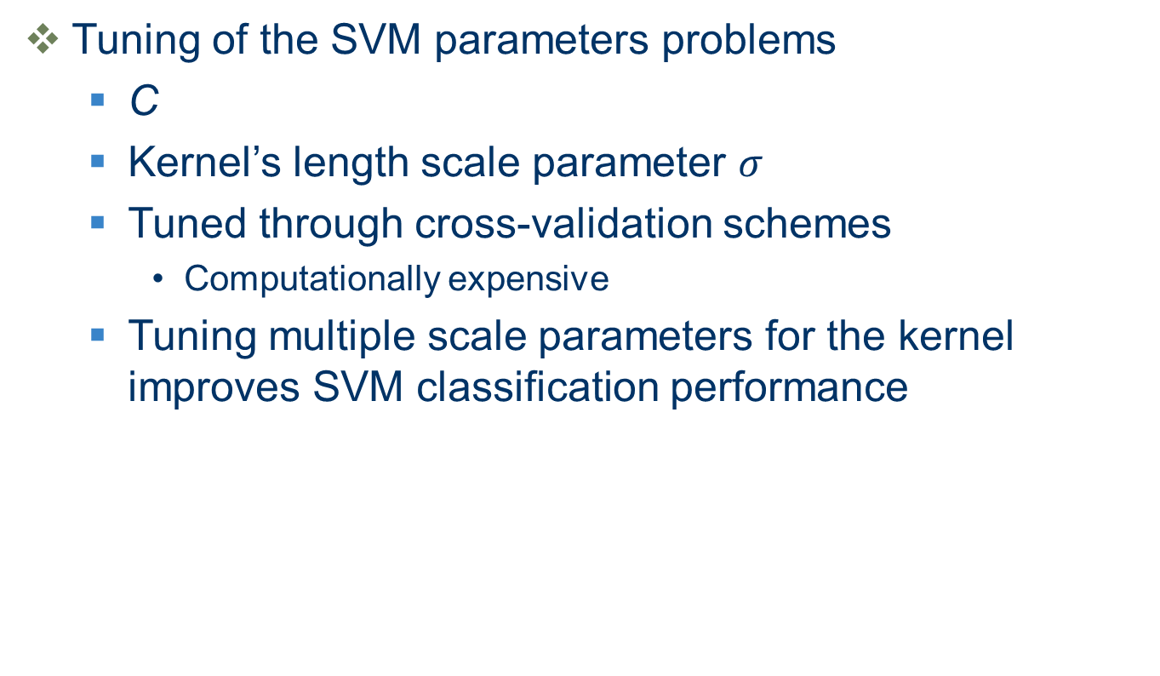
Support Vector Machine
Tuning of the SVM parameters problems
C
Kernel’s length scale parameter $σ$
Tuned through cross-validation schemes
Computationally expensive
Tuning multiple scale parameters for the kernel improves SVM classification performance

Slide 7
Local Support Vector Machine
SVM
Effective classification tool
Training and testing is computationally expensive
Tuning the kernel parameters is a complicated procedure
k-Nearest Neighbor (k-NN)
With the right distance measure, k-NN can out-perform far more sophisticated alternatives
Classifier is computationally efficient
Deals with multiclass problems effortlessly

Slide 8
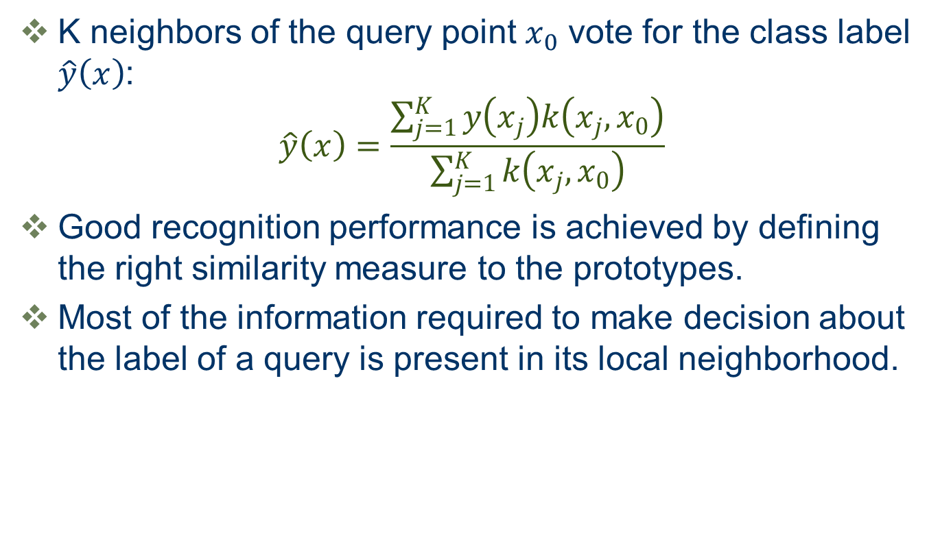
Local Support Vector Machine
K neighbors of the query point $x_{0}$ vote for the class label $\hat{y}\left(x\right)$:
$$\hat{y}\left(x\right)=\frac{\sum_{j=1}^{K}{y\left(x_{j}\right)k\left(x_{j},x_{0}\right)}}{\sum_{j=1}^{K}{k\left(x_{j},x_{0}\right)}}$$
Good recognition performance is achieved by defining the right similarity measure to the prototypes.
Most of the information required to make decision about the label of a query is present in its local neighborhood.

Slide 9
Local Support Vector Machine
SVM + KNN = Local Support Vector Machine (LSVM)
Classification efficiency
Computational efficiency
Not train a single global SVM
A separate SVM can be trained for the neighbourhood of each query point

Slide 10
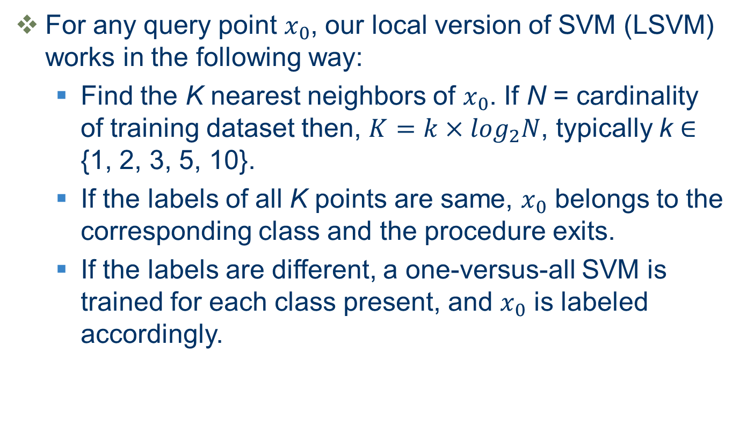
Local Support Vector Machine
For any query point $x_{0}$, our local version of SVM (LSVM) works in the following way:
Find the K nearest neighbors of $x_{0}$. If N = cardinality of training dataset then, $K=k×\log_{2}N$, typically k ∈ {1, 2, 3, 5, 10}.
If the labels of all K points are same, $x_{0}$ belongs to the corresponding class and the procedure exits.
If the labels are different, a one-versus-all SVM is trained for each class present, and $x_{0}$ is labeled accordingly.

Slide 11
Local Support Vector Machine
A major motivation for using LSVM is the gain in classification performance - yet while LSVM results in performance gain in some databases, performance deteriorates in many databases.
LSVM, however, has an advantage over standard SVM as it involves no initial training and extension to greater numbers of classes is more feasible.

Slide 12
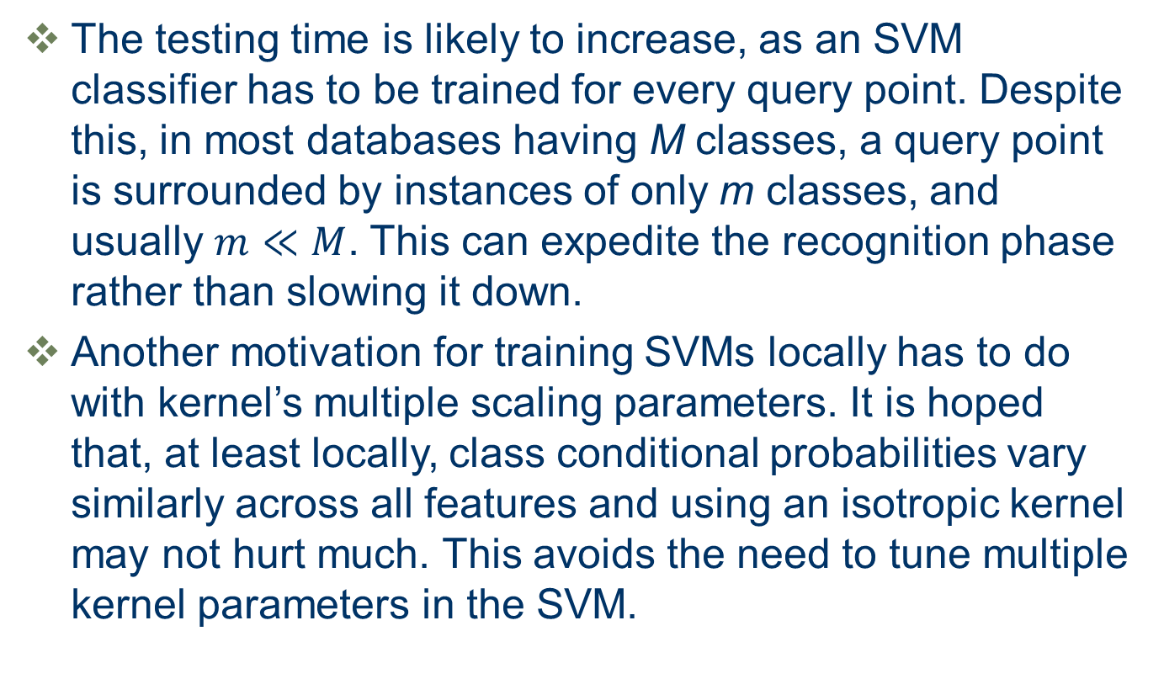
Local Support Vector Machine
The testing time is likely to increase, as an SVM classifier has to be trained for every query point. Despite this, in most databases having M classes, a query point is surrounded by instances of only m classes, and usually $m≪M$. This can expedite the recognition phase rather than slowing it down.
Another motivation for training SVMs locally has to do with kernel’s multiple scaling parameters. It is hoped that, at least locally, class conditional probabilities vary similarly across all features and using an isotropic kernel may not hurt much. This avoids the need to tune multiple kernel parameters in the SVM.

Slide 13
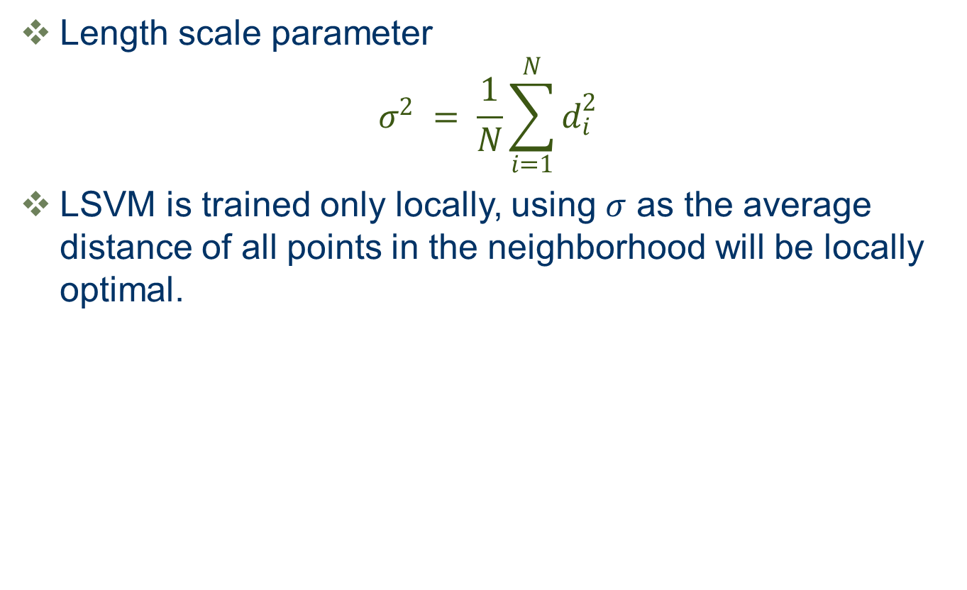
Local Support Vector Machine
Length scale parameter
$$σ^{2} = \frac{1}{N}\sum_{i=1}^{N}{d_{i}^{2}}$$
LSVM is trained only locally, using $σ$ as the average distance of all points in the neighborhood will be locally optimal.

Slide 14
Local Adaptive Support Vector Machine
KNN
LASVM
SVM
MEGM

Slide 15
Local Adaptive Support Vector Machine
The performance of LSVM is dependent on the neighborhood size in which it is trained. One expects that LSVM performance will be better for a larger neighborhood size, but increasing neighborhood size will result in a decrease in computational efficiency. Therefore, a neighborhood size has to be tuned such that an suitable trade-off is achieved between computational and classification efficiency.
An alternative approach to increase in classification performance, while keeping the size of the neighborhood small, is to train a local SVM in an adaptive neighborhood of the query point. We call this formulation the Local Adaptive Support Vector Machine (LASVM).

Slide 16
Local Adaptive Support Vector Machine
LASVM vs. Curse-of-Dimensionality (COD)
SVM classifiers are not immune to COD.
LASVM employs the strategy of modifying the distance metric.
Kernel to give appropriate weights to each feature
This results in some dimensions to be completely ignored
LASVM provides a framework for incorporating non-stationary kernels in the SVM framework.

Slide 17
Metric Learning and SVM
Recently a lot of work has been done in the area of metric learning to improve the performance of k-Nearest Neighbor (k-NN) classifier.
Metric learning algorithms aim at finding a metric that results in small intra-class and large inter-class distance.
A metric is parametrized by a norm and a positive semi-definite matrix. Typically an inverse square root of the distance matrix is estimated. That is, we learn a matrix parmeterizing the linear transformation of the input space such that, in the transformed space, k-NN performs well.

Slide 18
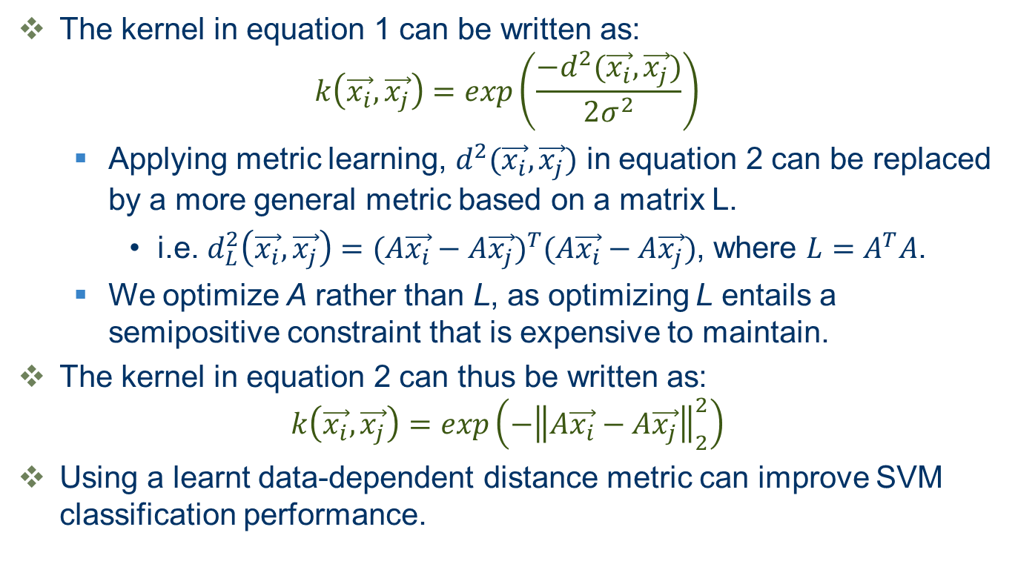
Metric Learning and SVM
The kernel in equation 1 can be written as:
$$k\left(\vec{x_{i}},\vec{x_{j}}\right)=exp\left(\frac{−d^{2}(\vec{x_{i}},\vec{x_{j}})}{2σ^{2}}\right)$$
Applying metric learning, $d^{2}(\vec{x_{i}},\vec{x_{j}})$ in equation 2 can be replaced by a more general metric based on a matrix L.
i.e. $d_{L}^{2}\left(\vec{x_{i}},\vec{x_{j}}\right)={(A\vec{x_{i}}−A\vec{x_{j}})}^{T}(A\vec{x_{i}}−A\vec{x_{j}})$, where $L=A^{T}A$.
We optimize A rather than L, as optimizing L entails a semipositive constraint that is expensive to maintain.
The kernel in equation 2 can thus be written as:
$$k\left(\vec{x_{i}},\vec{x_{j}}\right)=exp\left(−{\left\|A\vec{x_{i}}−A\vec{x_{j}}\right\|}_{2}^{2}\right)$$
Using a learnt data-dependent distance metric can improve SVM classification performance.
(2)
(3)

Slide 19
Mean Square Error Gradient Minimization
In this work, we have used the Mean Square Error Gradient Minimization (MEGM) metric learning algorithm from our previous work. Other metric learning algorithms can also be used. Notable examples include Neighborhood Component Analysis (NCA), Information Theoretic Metric Learning (ITML), etc.
MEGM is based on the minimization of an MSE objective function using a gradient descent algorithm in the KNN framework.
A lot of work has also been done in locally adaptive metric learning algorithms. A local SVM can be trained on the transformed neighborhood that results from a local adaptive metric.
We have used MEGM, as we got better results with MEGM than with NCA [14], LMNN [15] and DANN [6].
Notes:
NCA: Neighborhood component analysis
LMNN: Large Margin Nearest Neighbor
DANN: Discriminative Adaptive Nearest Neighbor

Slide 20
Local Adaptive Support Vector Machine
LASVM:
Inspired by recent successes in metric learning for k-NN.
Learning a metric results in a linear transformation of the data.
LASVM trains an LSVM in the local space transformed by the learnt metric.

Slide 21
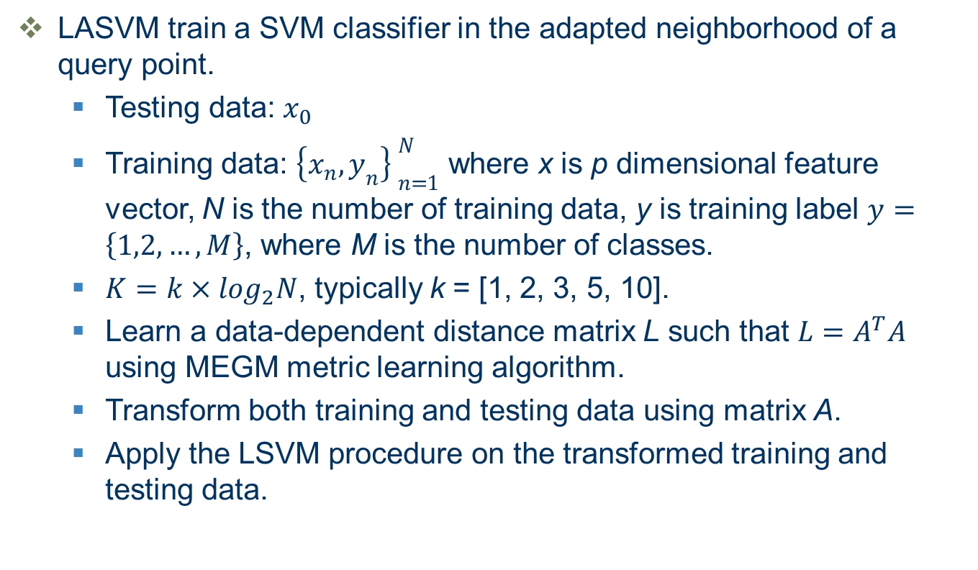
Local Adaptive Support Vector Machine
LASVM train a SVM classifier in the adapted neighborhood of a query point.
Testing data: $x_{0}$
Training data: ${\left\{x_{n},y_{n}\right\} }_{n=1}^{N}$ where x is p dimensional feature vector, N is the number of training data, y is training label $y=\left\{1,2,…,M\right\}$, where M is the number of classes.
$K=k×\log_{2}N$, typically k = [1, 2, 3, 5, 10].
Learn a data-dependent distance matrix L such that $L=A^{T}A$ using MEGM metric learning algorithm.
Transform both training and testing data using matrix A.
Apply the LSVM procedure on the transformed training and testing data.

Slide 22
Experimental Results
The performance of LSVM and LASVM is compared on following databases:
yalefaces, yalefacesB, AT&Tfaces
caltechfaces, caltechfacesB
isolet, USPS, Coil100
UCIML databases

Slide 23
Experimental Results
The Faces, USPS, Isolet, and Coil100 databases were preprocessed (by PCA) for efficiency.
For faces, USPS, Isolet and Coil100, each experiment is repeated 10 times and the mean results and standard deviations are reported. Note that no optimization is done for LSVM and LASVM.
C parameter is set equal to 10 and σ is set equal to 1 for all experiments in all LSVM and LASVM formulations.
Notes:
Pre-processing images using PCA is a common approach in object recognition experiments to reduce dimensionality. This can result in vastly reduced computational cost. In our experiments, the results are obtained by reducing the dimensionality of images by projecting data on the first few eigenfaces.

Slide 24
Experimental Results
Database | #Data | #Features | #Classes | PCA | #Train/Class | #Test/Class
yalefaces | 165 | 77760 | 15 | 50 | 4 | 7
yalefacesB | 5850 | 307200 | 10 | 20 | 10 | 20
caltechfaces | 435 | 47500 | 29 | 30 | 5 | 10
caltechfacesB | 435 | 47500 | 2 | 30 | 50 | 100
AT&Tfaces | 400 | 10304 | 40 | 50 | 5 | 5
Coil100 | 7200 | 16384 | 100 | 50 | 10 | 10
USPS | 9298 | 256 | 10 | 50 | 20 | 10
Isolet | 6238 | 617 | 26 | 50 | 20 | 10
Table I Details of Faces, USPS, Isolet and Coil100 databases used for classification
Notes:
Yalefaces, YalefacesB, AT&T and Caltechfaces were used to study local adaptive SVM performance.
The Yalefaces, YalefacesB and AT&T databases are well-known in face recognition research. Caltechfaces and CaltechfacesB constitute images from the face category in the Caltech-101 object database.
The Caltech-101 face category has 435 images of around 20 people. The Caltechfaces database in table I is based on splitting the Caltech-101 face category into 20 categories, each belonging to a different person. On the other hand, CaltechfacesB in table I is based on splitting the Caltech-101 face category into two classes only: male and female.

Slide 25
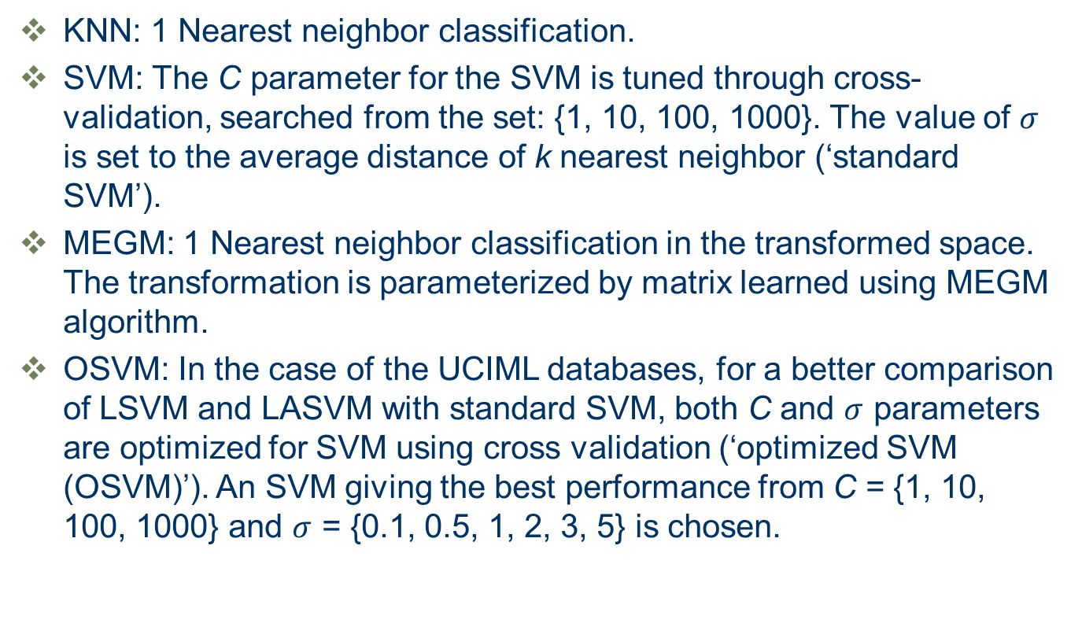
Experimental Results
KNN: 1 Nearest neighbor classification.
SVM: The C parameter for the SVM is tuned through cross-validation, searched from the set: {1, 10, 100, 1000}. The value of $σ$ is set to the average distance of k nearest neighbor (‘standard SVM’).
MEGM: 1 Nearest neighbor classification in the transformed space. The transformation is parameterized by matrix learned using MEGM algorithm.
OSVM: In the case of the UCIML databases, for a better comparison of LSVM and LASVM with standard SVM, both C and $σ$ parameters are optimized for SVM using cross validation (‘optimized SVM (OSVM)’). An SVM giving the best performance from C = {1, 10, 100, 1000} and $σ$ = {0.1, 0.5, 1, 2, 3, 5} is chosen.
Notes:
Note that all SVM formulations are trained with a Gaussian kernel and a one-versus-all strategy is employed.

Slide 26
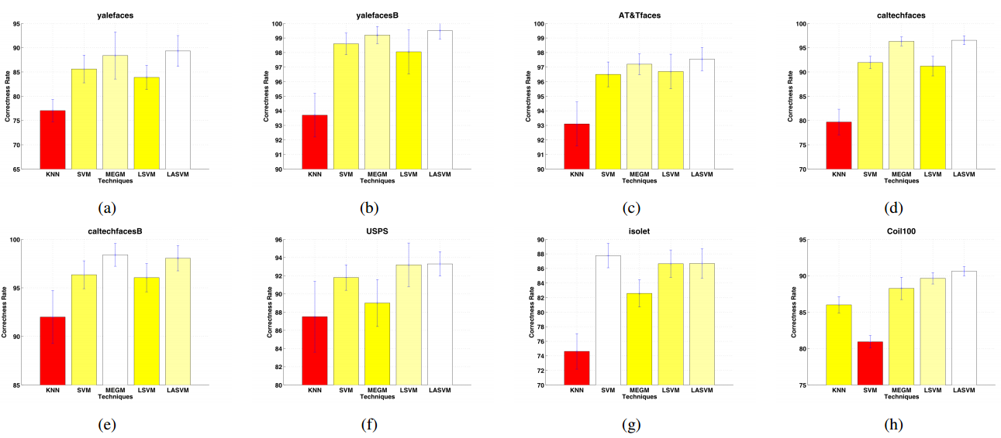
Experimental Results
Comparison of the correctness rates of LSVM and LASVM method with KNN, SVM, MEGM methods on faces, USPS, Isolet and Coil100 database.

Slide 27
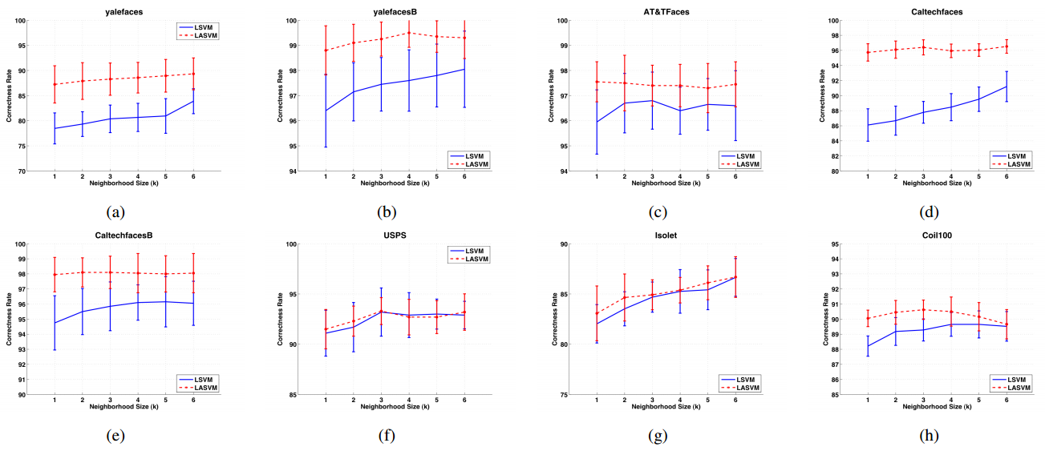
Experimental Results
Comparison of LSVM and LASVM performance on faces, USPS, Isolet and Coil100 database by varying neighborhood size k.

Slide 28
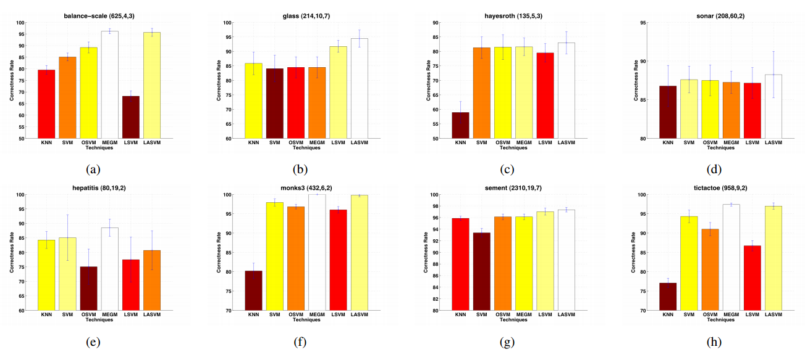
Experimental Results (UCIML databases)
Comparison of the correctness rate of LSVM and LASVM with KNN, SVM, OSVM, MEGM methods on UCIML databases.

Slide 29
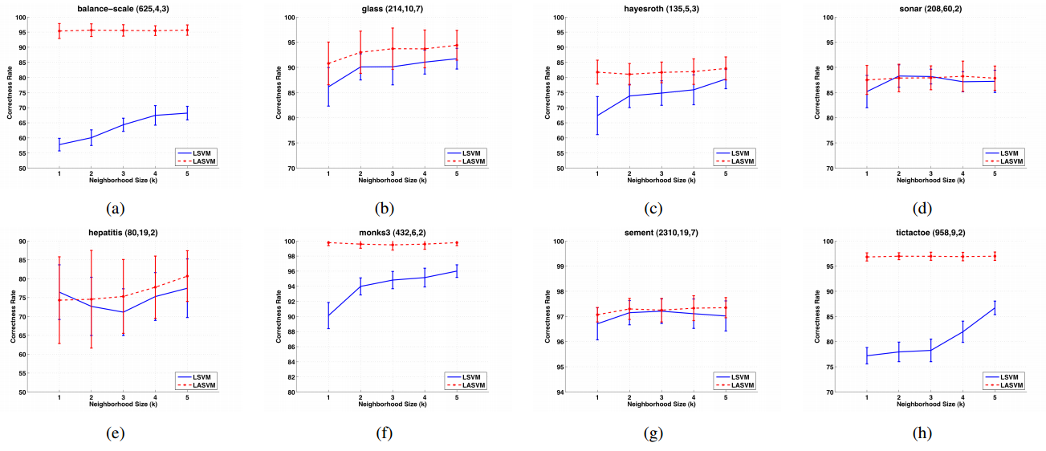
Experimental Results (UCIML databases)
Comparison of the correctness rate of LSVM and LASVM by varying the neighborhood size k on UCIML databases.

Slide 30
Discussion
First, no SVM parameters are optimized in the cases of LSVM and LASVM. Our results are thus encouraging not only for LASVM, but also for LSVM, as LSVM performance is comparable in some cases to standard SVM and OSVM. For example, in the case of Coil100 database, using LSVM results in a very large performance gain over standard SVM.

Slide 31
Discussion
Secondly, due to space constraints, we have not reported computational time in this work. In our experiments we found that training LSVM and LASVM was far more efficient in term of computational efficiency compared to standard SVM, provided we keep the neighborhood size reasonably small.

Slide 32
Discussion
Thirdly, although LSVM performs better than SVM in some cases, it does worse in many others. This suggests that the LSVM algorithm proposed in Zhang et al., ought not be used with simple Euclidean distance. Indeed Zhang et al. have proposed to use LSVM with a specifically designed distance measure. Our locally adaptive formulation LASVM resulted in far superior performance when compared with LSVM.

Slide 33
Conclusion
LASVM resulted in significant improvement over the performance of not only LSVM, but also SVM, KNN, and MEGM classifiers on faces, object, digit, and UCIML databases.
We found that, unlike LSVM, LASVM performance is not greatly affected by the neighborhood size. These results are promising and point to an interesting direction for further research.
We also highlighted some advantages of LSVM methods and described how they can help alleviate kernel parameter tuning problems.

Slide 34
Conclusion
Our results on LSVM suggest that it should not be viewed as a replacement for SVM, but as a compromise between SVM and KNN. LSVM is especially useful in cases where the number of classes is very large, as LSVM is faster than standard SVM and has better performance than KNN.
Our LASVM results, on the other hand, are encouraging and needs to be investigated further with other metric learning algorithms.

Slide 35
Reference
O. Chapelle, V. Vladimir, O. Bousquet, and S. Mukherjee, “Choosing multiple parameters for support vector machines,” Journal of Machine Learning Research, 2002.
A. Frome, Y. Singer, and J. Malik, “Image retrieval and classification using local distance functions,” in Proceedings of Neural Inforamtion and Processing Systems, 2006.
M.-E. Nilsback and A. Zisserman, “A visual vocabulary for flower classification,” in Proceedings of the IEEE Conference on Computer Vision and Pattern Recognition, vol. 2, 2006, pp. 1447–1454.
A. Berg, T. Berg, and J. Malik, “Shape matching and recognition using low distortion correspondence,” in Proceedings of the IEEE Conference on Computer Vision and Pattern Recognition, 2005.
S. Belongie, J. Malik, and J. Puzicha, “Shape matching and object recognition using shape contexts,” IEEE Transactions on Pattern Recognition, 2005.
T. Hastie and R. Tibshirani, “Discriminative adaptive nearest neighbor classification,” IEEE transactions on Pattern Analysis and Machine Intelligence, 1996.
E. Rosch, “Natural categories,” Cognitive Psychology, 1973.
H. Zhang, A. Berg, M. Maire, and J. Malik, “Svm-knn: Discriminative nearest neighbor classification for visual category recognition,” in Proceedings of the IEEE Conference on Computer Vision and Pattern Recognition, 2006.

Slide 36
Reference
M. Varma and D. Ray, “Learning the discriminative powerinvariance trade-off,” in Proceedings of the International Conference on Computer Vision, 2007.
J. Zhang, M. Marszalek, S. Lazebnik, and C. Schmid, “Local features and kernels for classification of texture and object categories: A comprehensive study,” in Proceedings of the IEEE Conference on Computer Vision and Pattern Recognition (Workshop paper), 2006.
T. Hastie, R. Tibshirani, and J. Friedman, The Elements of Statistical Learning. Springer Series in Statistics, 2001.
H. Cheng, P. Tan, and R. Jin, “Localized support vector machine and its efficient algorithm,” in Proceedings of the SIAM International Conference on Data Mining, 2007.
N. Zaidi and D. M. Squire, “A gradient-based metric learning algorithm for k-nn classifiers,” in Proceedings of the Australasian Joint Conference on Artificial Intelligence, 2010.
J. Goldberger, S. Roweis, G. Hinton, and R. Salakhutdinov, “Neighborhood component analysis,” in Proceedings of Neural Inforamtion and Processing Systems, 2005.
K. Weinberger, J. Blitzer, and L. Saul, “Distance metric learning for large margin nearest neighbor classification,” in Proceedings of Neural Inforamtion and Processing Systems, 2006.

Slide 37
Thank You !
Group 9

